Slide 1
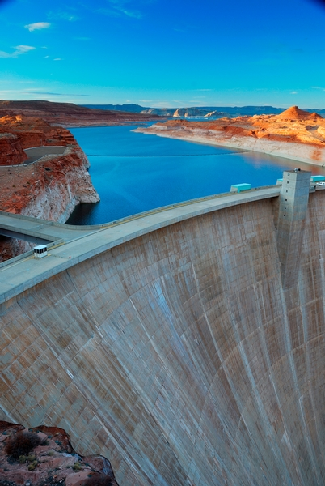


Terms Extension Opportunity Assessment
July 2024

Slide 2
Situation Summary for American Water
We understand that American Water is looking to optimize its working capital position with Taulia’s holistic Working Capital Management platform.
Taulia analyzed the spend and supplier relationships across American Water’s global spend file to highlight the working capital trapped within American Water’s supply chain.
Highlights:
* Working Capital Potential: Total potential working capital within American Water’s existing supply chain is ~$250M based on 100% extension adoption.
* Impact to Discounts: Significant discount potential with peak liquidity demand.
* Industry Analysis: Taulia expects American Water should be able to generate significant working capital across its top-10 largest supplier industry groups.
By aligning payment terms with industry norms and leveraging Taulia’s platform, American Water can unlock significant working capital and efficiency gains.
© 2023 Taulia LLC. Confidential information. Do not distribute.

Slide 3
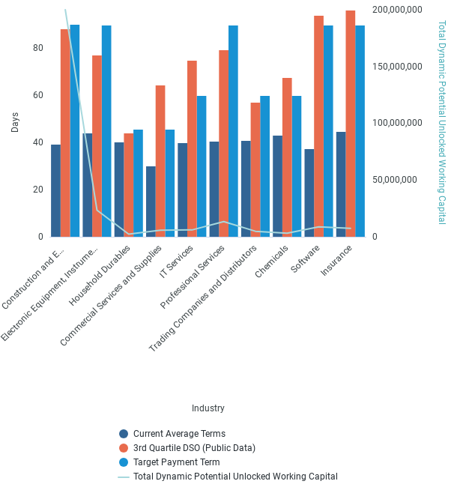
Industry Term Comparison
© 2023 Taulia LLC. Confidential information. Do not distribute.

Slide 4
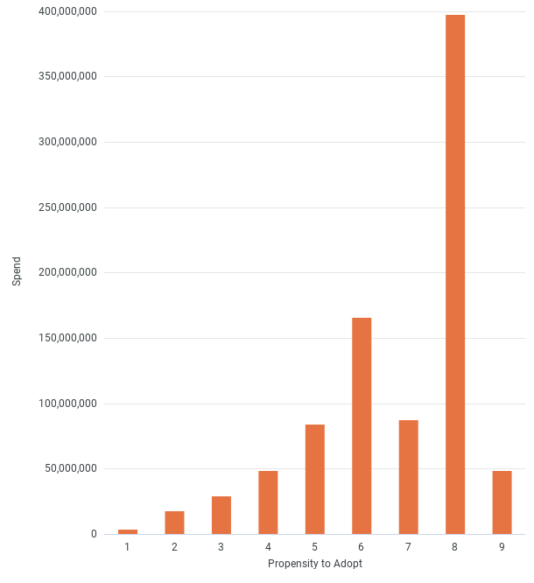
Card Adoption
© 2023 Taulia LLC. Confidential information. Do not distribute.

Slide 5
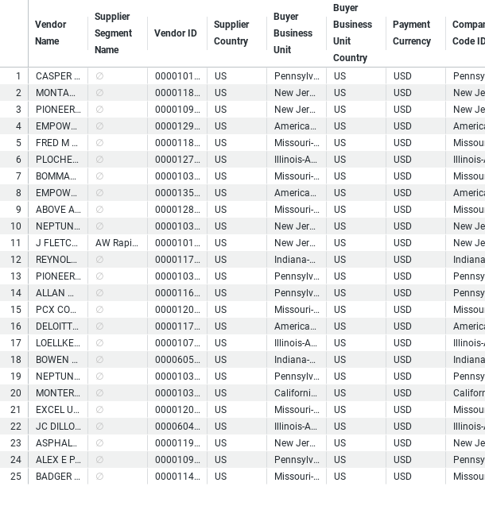
Top WC Potential Suppliers
© 2023 Taulia LLC. Confidential information. Do not distribute.

Slide 6
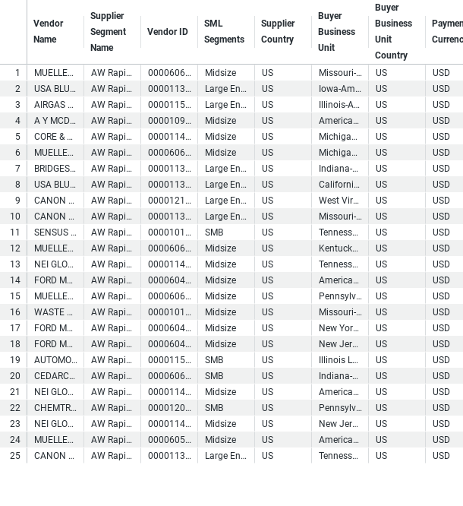
Buyer - Payables Planner Supplier List
© 2023 Taulia LLC. Confidential information. Do not distribute.

Slide 7
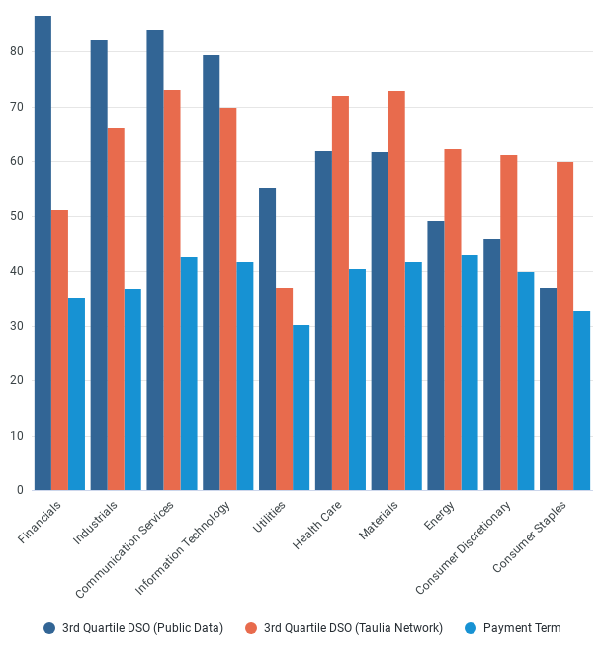
Supplier Payment Terms Comparison
© 2023 Taulia LLC. Confidential information. Do not distribute.

Slide 8
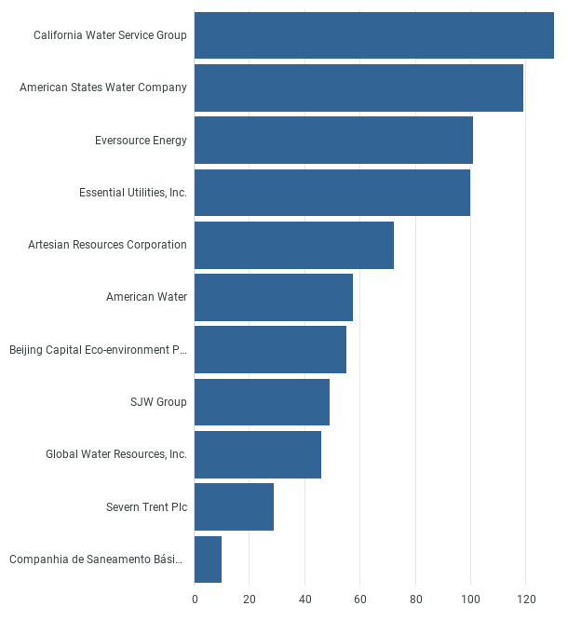
Peer DPO
© 2023 Taulia LLC. Confidential information. Do not distribute.

Slide 9
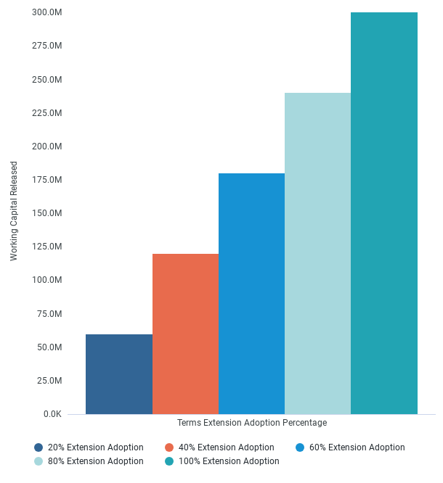
Working Capital Released
© 2023 Taulia LLC. Confidential information. Do not distribute.

